Slide 1

HOUSING PROJECT
Submitted By:
Praveen Kumar Singh

Slide 2
Problem Statement
Houses are one of the necessary needs of each and every person around the globe and therefore housing and real estate market is one of the markets which is one of the major contributors in the world’s economy. It is a very large market and there are various companies working in the domain. Data science comes as a very important tool to solve problems in the domain to help the companies increase their overall revenue, profits, improving their marketing strategies and focusing on changing trends in house sales and purchases.
Predictive modelling, Market mix modelling, recommendation systems are some of the machine learning techniques used for achieving the business goals for housing companies. Our problem is related to one such housing company.

Slide 3
Understanding
Build a model which can be used to predict in terms of a probability for each housing factor, the price prediction for a house sale in Australia.
Knowledge of real-life real-estate companies would help to better understand the different variables given in the dataset. It will in turn help us to leverage the correlation of the variables.
The motive behind this project is to create a ML model that predicts with the given conditions the price of a house up for sale.

Slide 4
EDA
Removing unwanted columns.
Checking the distribution.
Plotting Correlation.
Removing columns with low correlation.
Removing correlation pairs.
Checking outliers.
Checking skewness
Encoding
Scaling

Slide 5
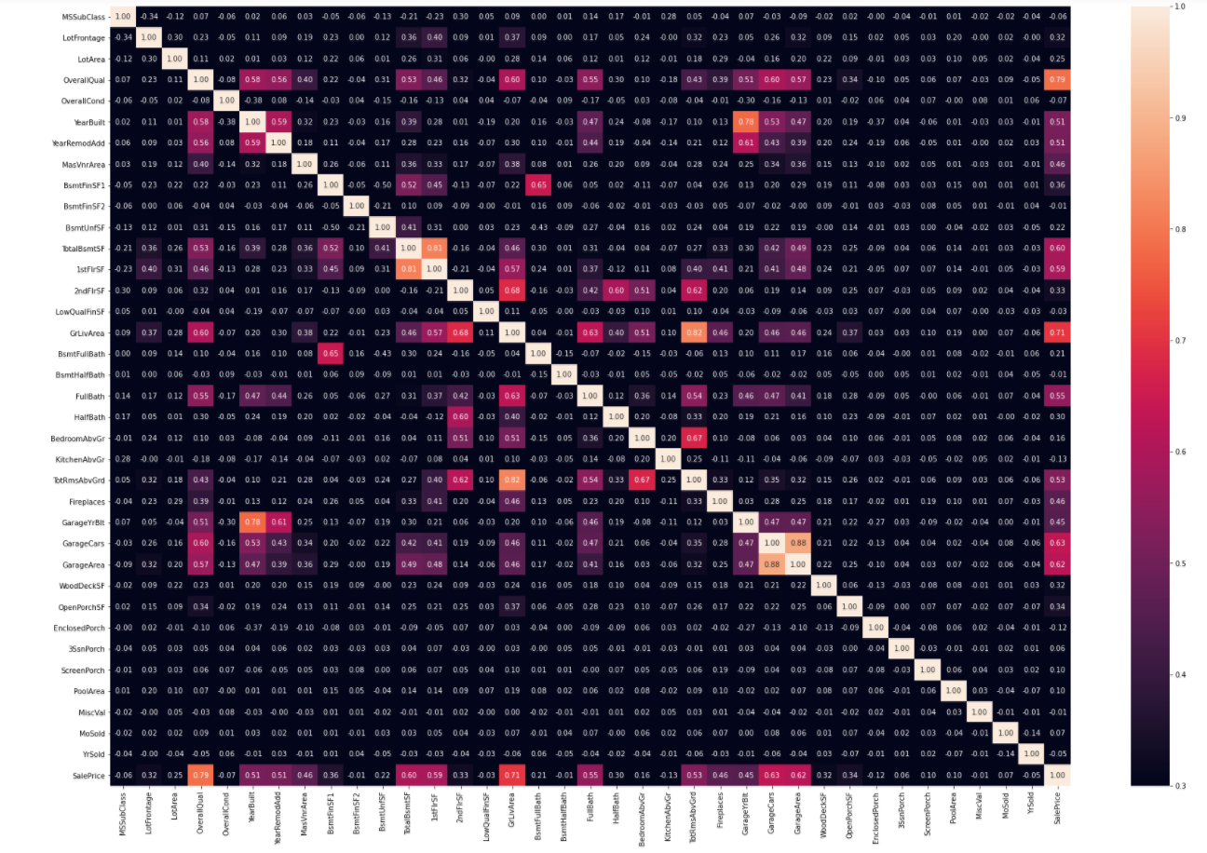
Visualizations
Model before removing unwanted columns

Slide 6
Steps
These are the models that I’ve tested to find the best model.
Linear Regression
K-Neighbors Regressor
Decision Tree Regressor
SVR
Random Forest Regressor
Lasso
Ridge
Elastic Net

Slide 7
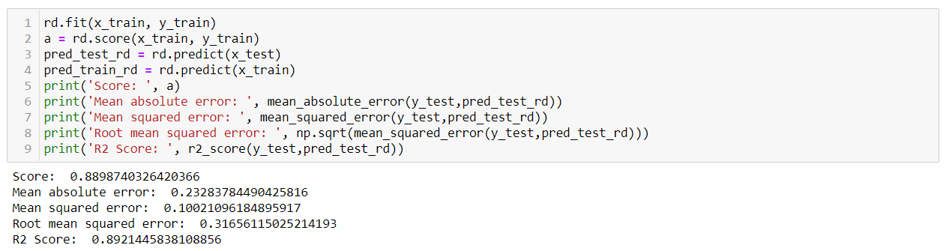
Model dashboard

Slide 8
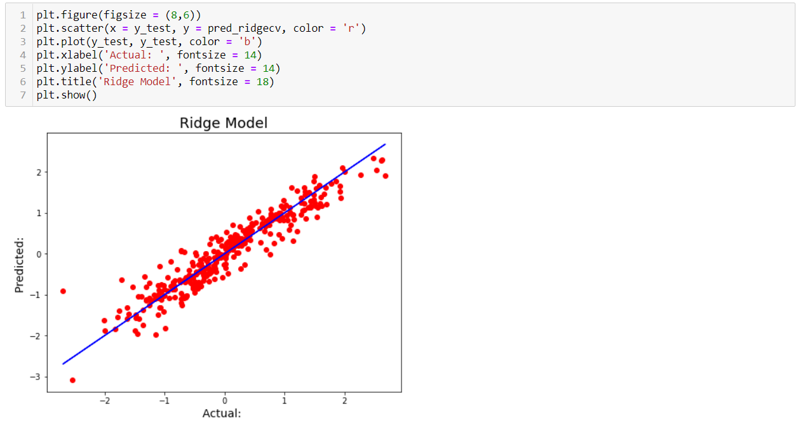
Finalized model
We have finalized the best model to be Ridge Regression

Slide 9
Conclusion
We’re getting a model with about 89.2% accuracy post Cross Validation and Grid Search CV with all listed parameters.
Both Lasso and Ridge models gave a good R2 Score in the preliminary run, but on further inspection, Ridge turned out to be the best working model. On further running with the Cross validation, we were able to find that the difference between R2 Score and CV score were less for all the models, however, I went with ridge taking into consideration the low difference in values for all the models and the comparatively higher score for the Ridge Model.
I have created a model which gives me a good accuracy in terms of predicting the prospect price of a house with the parameters listed.

